Slide 1
CSE3018 – J COMP
UNDERWATER IMAGE ENHANCEMENT
Team members
amRITH JAGANATH G - 19BCE1138
ROHITH M - 19BCE1086
YASHWWANTH B S - 19BCE1096

Slide 2
ABSTRACT
Underwater image enhancement and reconstruction is a challenging task and has gained priority in recent years, as the human eye cannot clearly perceive underwater images. The image acquisition systems fails to capture images with significant detail when used at greater depths underwater, such equipment is also expensive. Thus, with the use of image processing algorithms it is possible to reconstruct and enhance the image quality in the absence of reliable and costly image acquisition systems. We, therefore compare four different approaches for the enhancement and reconstruction of underwater images. First, we use white-balancing technique. Secondly we perform Gamma Correction on the image. Image sharpening is the third approach taken. Lastly, we use the adaptive retinal mechanism.

Slide 3
PROBLEM STATEMENT
Images captured underwater typically suffer from problems of color cast (bluish tinge) due to the color scattering effect shown by water (as a medium), crinkle pattern due to random deflection of light rays, haze due to suspended particles, attenuation of the light reaching the depths of the ocean from the surface of water. Absorption of light reduces light energy whereas scattering of light changes direction of light propagation. Underwater image enhancement with the help of various image enhancement algorithms like ARM, white balancing, image sharpening and Gamma correction.

Slide 4
REQUIREMENTS
SOFTWARE
MATLAB-The choice of software is justified because of its well built image processing toolbox, providing wide range of functions.

Slide 5
Why is it important ?
Underwater images often suffer from noise, color distortion and low contrast, because light is attenuated when it propagates through water.
These problems increase the difficulty of various tasks such as inspection of underwater infrastructures and cables , detection of man made objects , control of underwater vehicles , marine biology research, and archeology automatic fish and plankton detection and recognition.

Slide 6
Why do images appear green-bluish underwater?
All the images can be divided into 3 color components : Red, Green, and Blue. Out of three Colors the green channel is relatively well preserved and red gets lost first due to larger wavelength. The blue channel may be significantly attenuated due to absorption by organic matter. The order of the wavelength of the three colors are:
Red - 700-635 Nm
Green - 560- 520 Nm
Blue - 440 - 485 Nm

Slide 7
PROCESSING OF IMAGE
White Balancing
Gamma Correction
Image Sharpening
Adaptive Retinal Mechanism

Slide 8
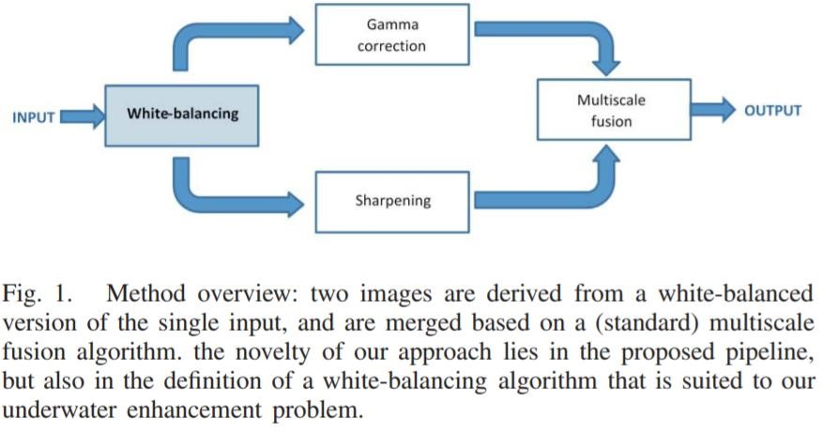
Source [1]

Slide 9
WHITE BALANCING
White balancing stage aims at removing the color cast induced by underwater light scattering, so as to produce a natural appearance of the sub-sea images. The multi-scale implementation of the fusion process results in an artifact-free blending.

Slide 10
WHY DO GAMMA CORRECTION ?
Gamma correction aims at correcting the global contrast and is relevant since, in general, white balanced underwater images tend to appear too bright. This correction increases the difference between darker/lighter regions at the cost of a loss of details in the under-/over-exposed regions.

Slide 11
IMAGE SHARPENING
To compensate for the loss of details due to Gamma Correction , we derive a second input that corresponds to a sharpened version of the white balanced image. Therefore, we follow the unsharp masking principle,in the sense that we blend a blurred or unsharp (here Gaussian filtered) version of the image with the image to sharpen.

Slide 12
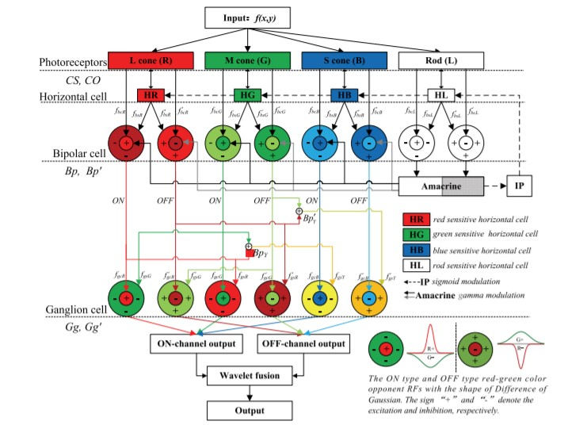
USING ADAPTIVE RETINAL MECHANISM

Slide 13
The network structure of the proposed model. The R, G and B components of the input color image are respectively sent into the corresponding cone types at the level of cone photoreceptor, the outputs of which are modulated by horizontal cells with quite large receptive fields (RFs). The modulated cone signals are then iteratively processed by the single-opponent retinal ganglion cells (RGCs), the RF of which consists of a small excitatory center and a relatively large inhibitory surround (also named the non-classical receptive field, nCRF). The surround is composed of many inhibitory subunits, which first inhibit each other, and then inhibit the center. The iterative processing in RGCs is executed in each opponent channel of R-G, G-R and B-Y till the channel’s output is stable. In the expression of “A-B”, “A” and “B” denote respectively the signal components received by the excitatory center and the inhibitory surround.

Slide 14
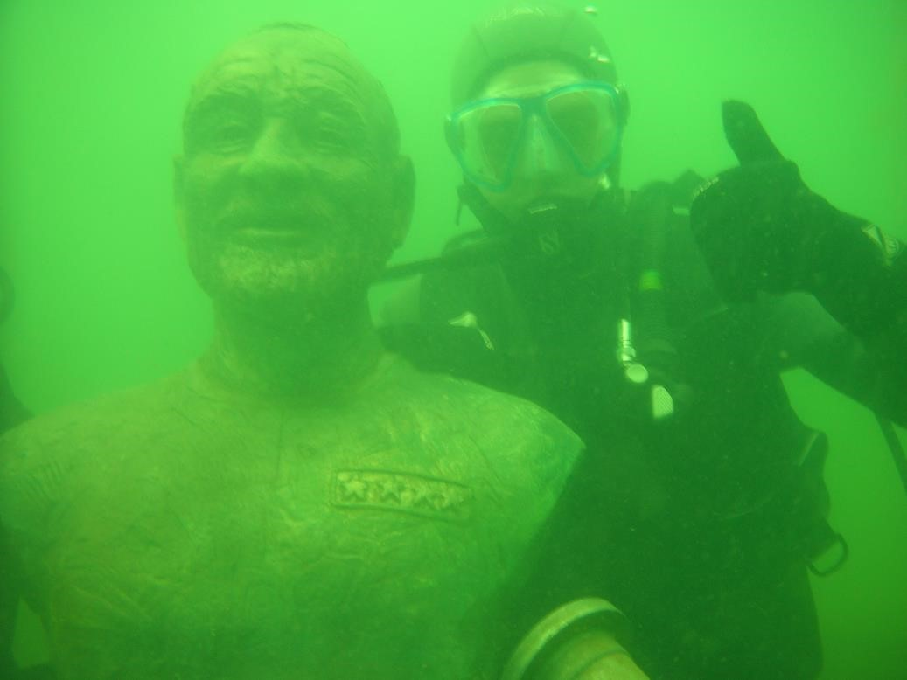
INPUT IMAGE

Slide 15
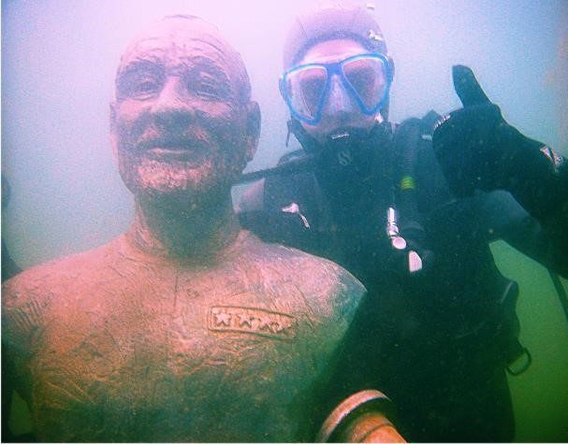
OUTPUT IMAGE

Slide 16
REFERENCE PAPERs
https://www.ias.ac.in/public/Volumes/sadh/041/02/0225-0238.pdf
https://pubmed.ncbi.nlm.nih.gov/28981416/
https://www.researchgate.net/publication/290442647_A_Retinal_Mechanism_Inspired_Color_Constancy_Model
https://www.ijert.org/research/improved-clahe-enhancement-technique-for-underwater-images-IJERTV9IS070064.pdf

